Slide 1
Introduction to Data Analytics and Visualisation
A short course on Tableau

Slide 2
Table of Contents
1
Welcome: Learning Objectives & Introductions
2
Part 1 – Understanding Data
3
Part 2 – An Introduction to Data Visualisation
4
Part 3 – Tableau as a Tool for Business Analytics & Visualisation
5
Part 4 – Basic Data Visualisation
6
Part 5 – Advanced Data Visualisation
7
Part 6 – Dashboard & Storyboards
You will need Tableau Desktop 2021 installed for this seminar

Slide 3
Welcome: Learning Objectives & Introductions

Slide 4

About the Instructor
Munish Kumar, PhD, B Eng
Staff Geoscientist (Petrophysicist) – ERCE
12 years in oil & gas; worked at ExxonMobil and Total S.A. in strategy, portfolio, planning, upstream exploration, field development and production optimization
In 2020, joined expert consultancy firm ERCE which provides energy consulting/auditing services (including greenhouse gas evaluation) to oil & gas, law firms, banks, institutional investors etc.
Adjunct Faculty – SUSS
Data Visualisation for Business
Python for Business
Applied Project for Business Analytics
Name
Profession/ What you do/ What you like
Do you currently use visualisation?
What would be one thing you want to take away from this class?
Tools of the trade: Python, Tableau, Power BI, Excel

Slide 5
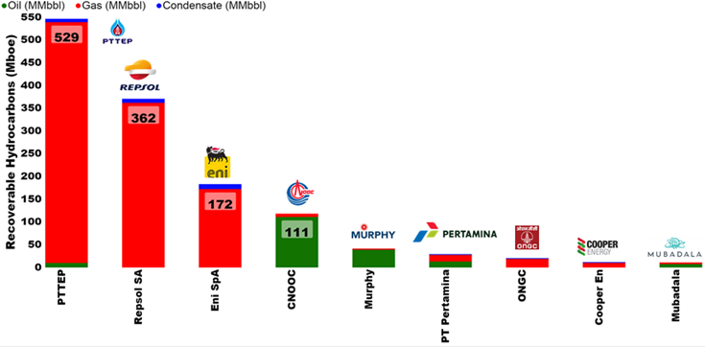
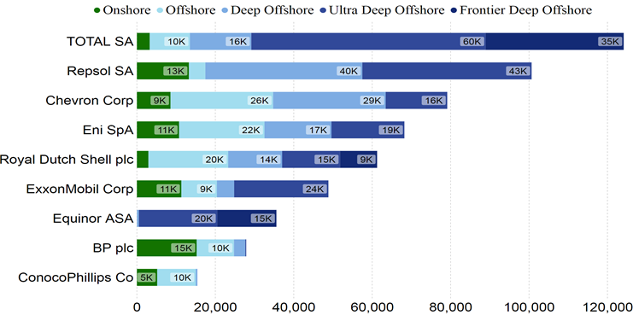
Learning Objectives
Understand concepts of Data and Data Visualization
Stages of Data Visualization Process
Data Visualization Components
Design Principles of a Business Performance Dashboard
Appropriateness of Data Visualization techniques based on available data
Appropriates of Business Performance Measure against Business Strategy of Organization
Some Textbooks:
Yau, N,.(2013). Data Points: Visualization that Means Something
Murray, D. G. (2013). Tableau Your Data

Slide 6
Part 1 – Understanding Data

Slide 7
Understanding Data
The four measurement levels of data quality attribute
Nominal measurements measure items based on their labels or categories or other qualitative classification the items belong to with no implied order
Ordinal measurements arise from the operation of rank ordering
Interval measurements allow us to measure the degree of difference between items, but not the ratio between them
Ratio measurements estimate the ratio between a magnitude of a continuous quantity and a unit magnitude of the same kind

Slide 8




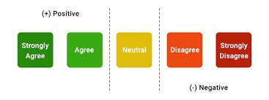



Understanding Types of Data
Types of Data
Qualitative
Quantitative
Arithmetic
Measuring the data
Nominal
Ordinal
Interval
Ratio
○K
Unordered
Ordered Words
Discrete
Continuous
No True Zero

Slide 9
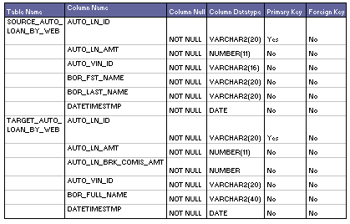
Understanding Data
Metadata
Metadata is structured information that explain, describe or locate the original (i.e. also known as primary data), otherwise make the using of original data more efficient
Source: http://learndatamodeling.com/wp-content/uploads/2015/10/tmeta.gif

Slide 10
Part 2 – An Introduction to Data Visualisation

Slide 11
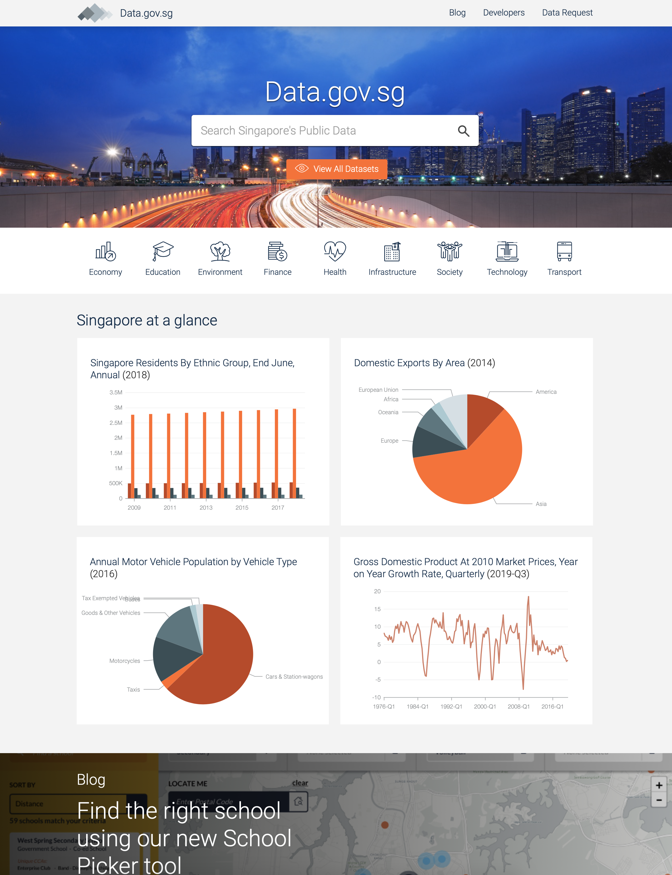
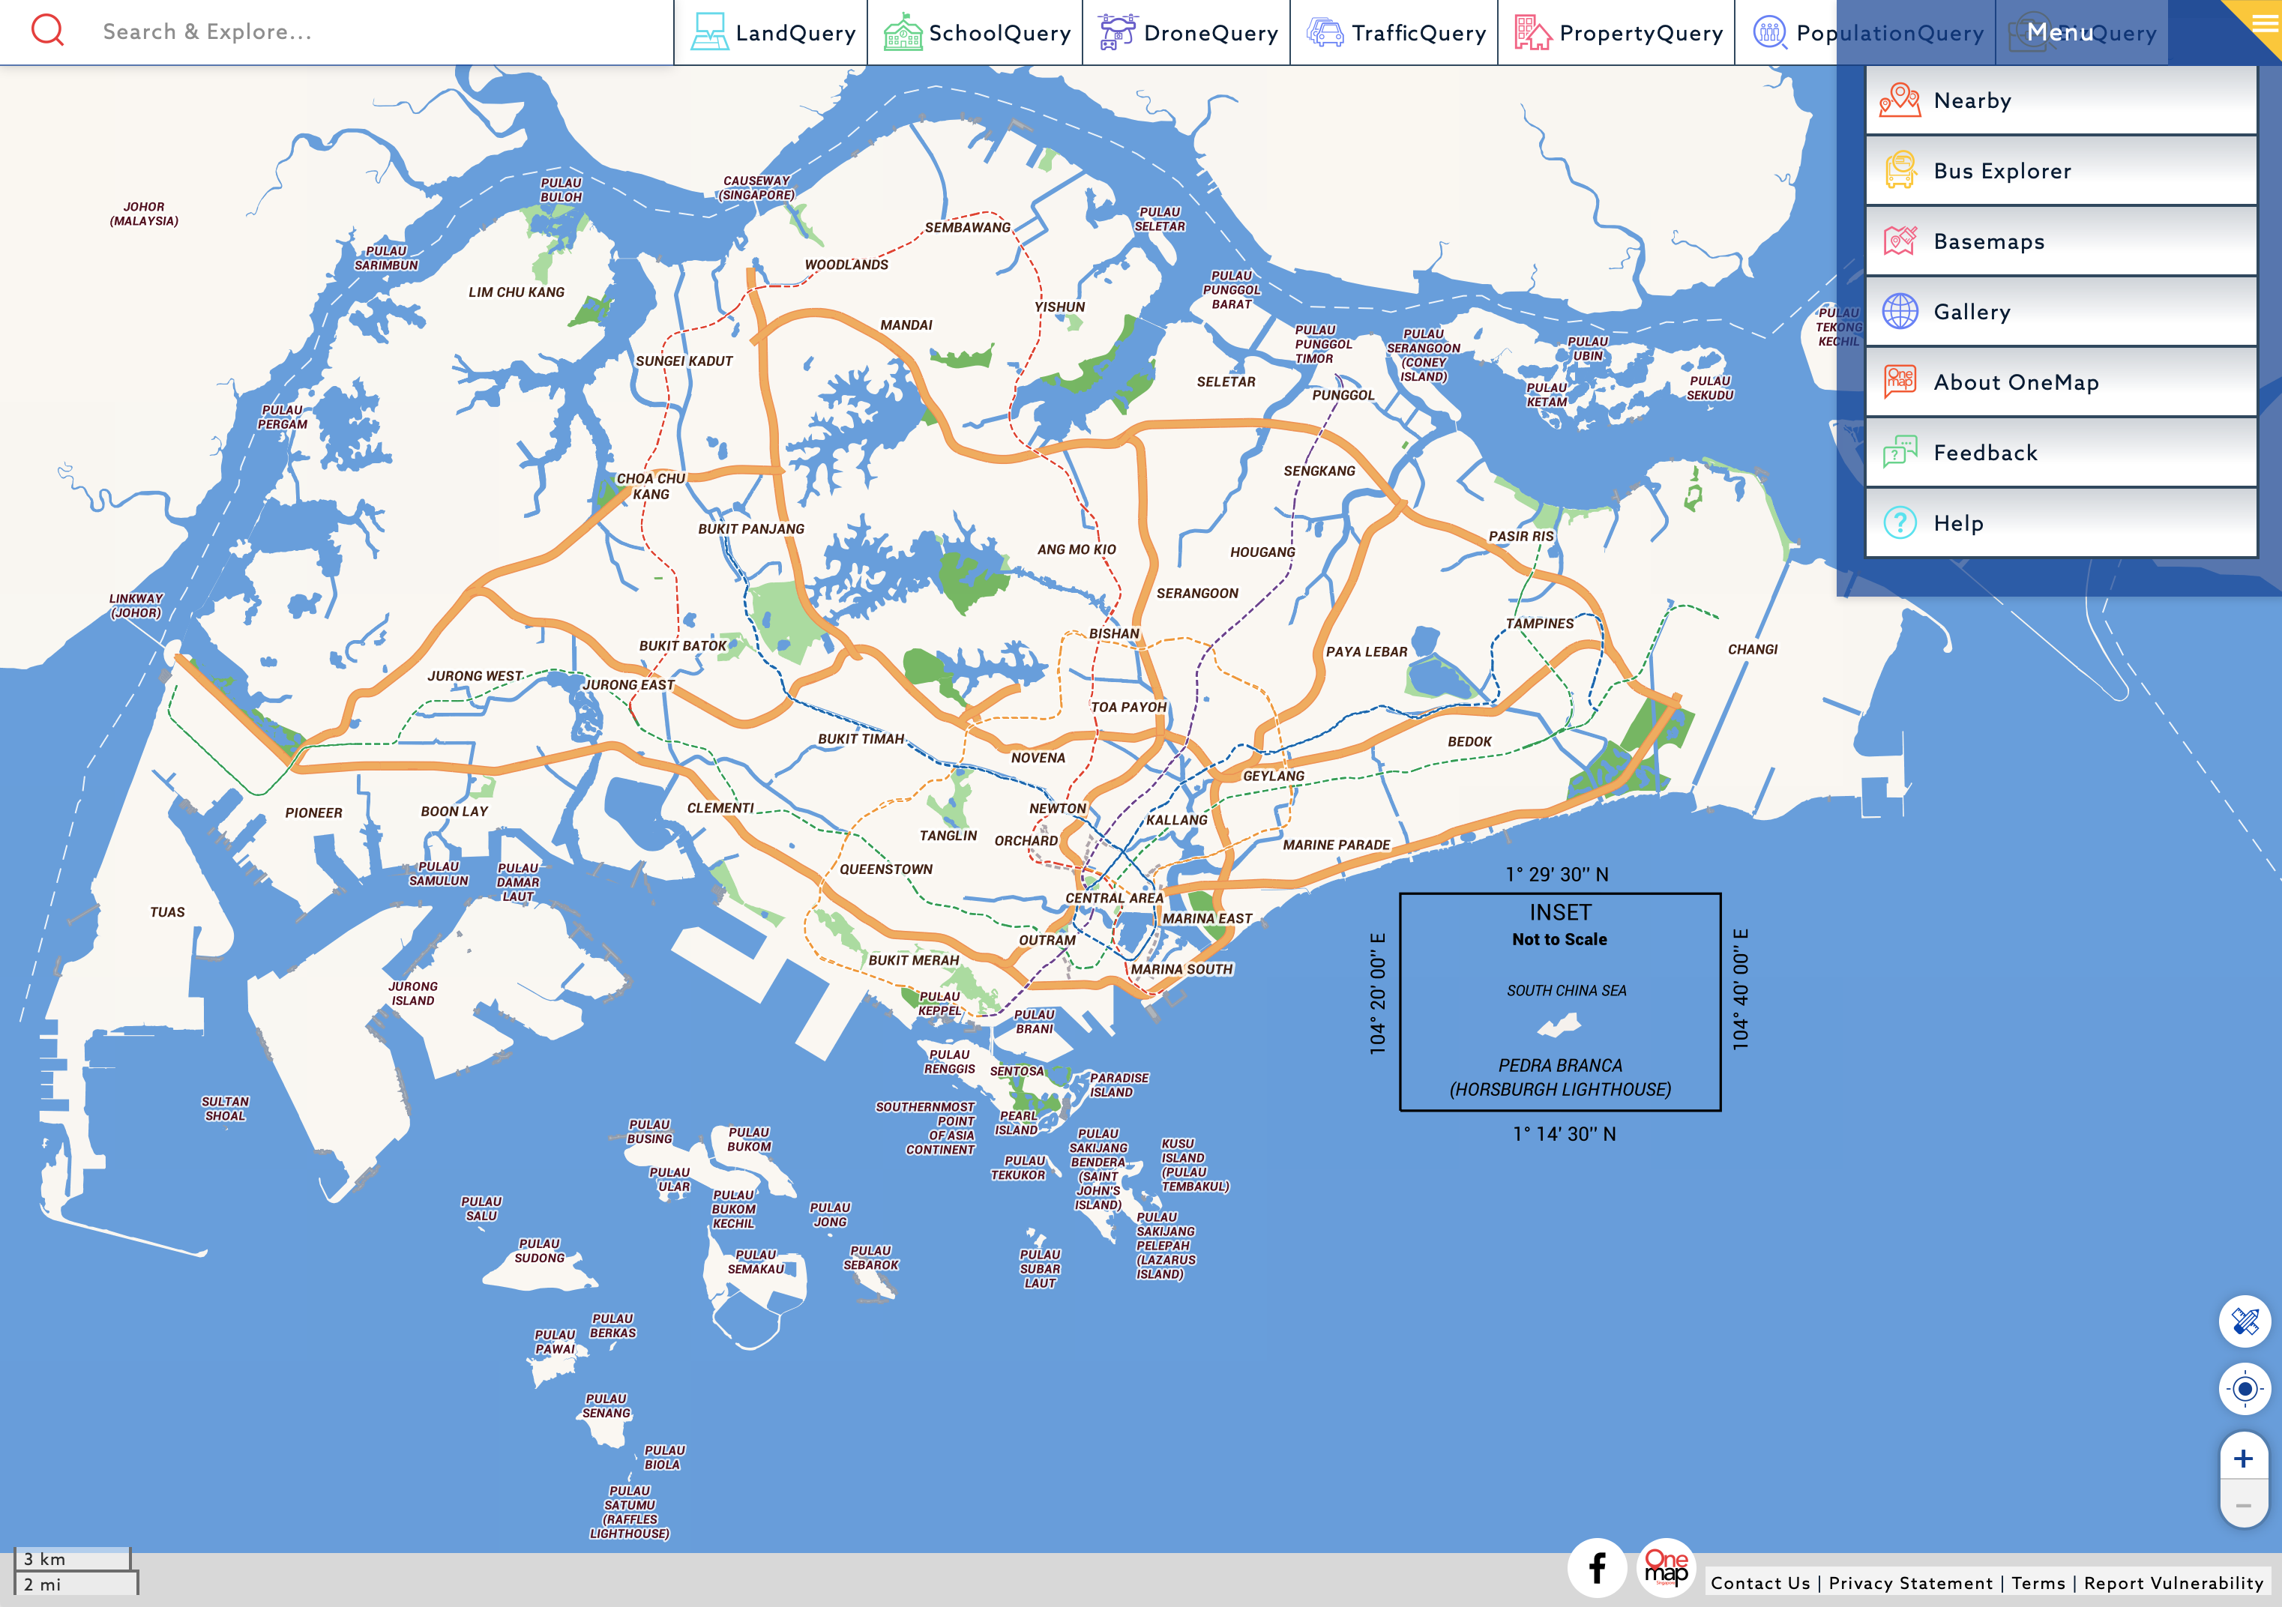
Data Visualisation
Overwhelming amount of data available today
A coloured map is essentially millions of data points/ measurements.
Overwhelming in an excel sheet, but easy to see if visualized properly

Slide 12
Data Visualisation
The four stages of the data visualisation process
Data Collection and Storage: the collection and storage of data
Data Pre-processing: the pre-processing of data to transform it into something one can understand
Graphics Engine: the display hardware and the graphics algorithms to produce data visualisation on screen
Human Visual and Cognitive Processing: human perceptual and cognitive systems that are involved in interpreting the visualised data
Source: Information Visualization: Perception for Design, C. Ware, 2013

Slide 13
Data Visualisation
Benefits
Provides us the ability to comprehend huge amounts of data
Allows the perception of emergent properties that are not anticipated (e.g. red for danger)
Often enable problems with data to become immediately apparent (missing data or blank (pixels))
Facilitates the understanding of both large-scale and small-scale features of the data
Facilitates hypothesis formation

Slide 14
Part 3 – Tableau as a Tool for Business Analytics & Visualisation

Slide 15
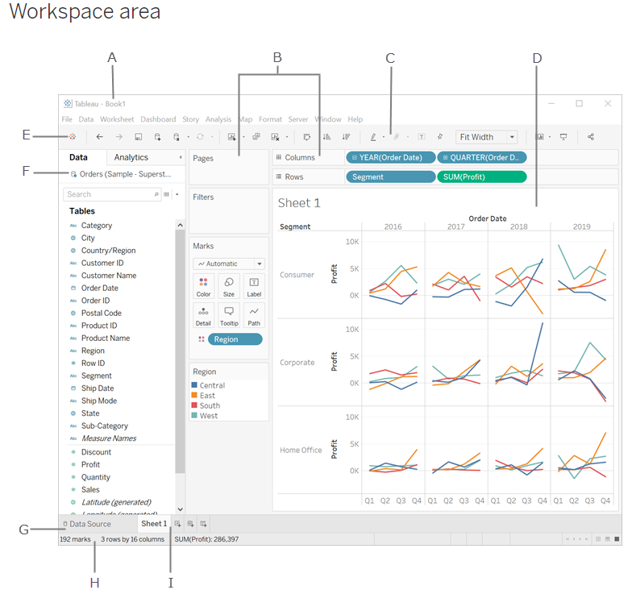
Tableau Interface
A. Workbook - contains sheets ( either a worksheet, dashboard, or story).
B. Cards and shelves - Drag fields to the cards and shelves in the workspace to add data to your view.
C. Toolbar - To access commands, analysis and navigation tools.
D. View - Workspace (Canvas) to create visualization ("viz").
E. Click this icon to go to the Start page to connect to data.
F. Side Bar- Contains the Data pane and the Analytics pane.
G. Data Source page - view and manipulate your data.
H. Status bar - Displays information about the current view.
I. Sheet tabs - Tabs represent each sheet (worksheets, dashboards, and stories) in your workbook.
Source: https://help.tableau.com/current/pro/desktop/en-us/environment_workspace.htm

Slide 16
Tableau File Extension
File Type | File Extension | Purpose
Tableau Workbook | .twb | It contains information on each sheet and dashboard that is present in a workbook. It has the details of the fields which are used in each view and the formula applied to the aggregation of the measures. It also has the formatting and styles applied. It also contains the data source connection information and any metadata information created for that connection.
Tableau Packaged Workbook | .twbx | This file format contains the details of workbook as well as the local data that is used in the analysis. Its purpose is to be share with other Tableau desktop or Tableau reader users assuming it does not need data from the server.
Tableau Data source | .tds | The details of the connection used to create the tableau report are stored in this file. In the connection details it stores the source type(excel/relational/sap etc.) as well as the data types of the columns.
Tableau Packaged Data source | .tdsx | This file is similar to the .tds file with the addition of data along with the connection details.
Tableau Data Extract | .tde | This file contains the data used in a .twb file in a highly compressed columnar data format. This helps in storage optimization. It also saves the aggregated calculations that are applied in the analysis. This file should be refreshed to get the updated data form the source.

Slide 17
Tableau Speak - Join, Union, Pivot, Relationships & Functions
Union vs Join
Union
Join
Month | Price | Quantity
Jan | 5 | 10
Month | Price | Quantity
Jan | 5 | 10
Month | Price | Quantity
Jan | 10 | 20
Month | Location
Jan | Bedok
Month | Price | Quantity
Jan | 5 | 10
Jan | 10 | 20
Month | Price | Quantity | Location
Jan | 5 | 10 | Bedok
Adding rows to existing data
Adding Columns to existing data

Slide 18
Tableau Speak – Join Types
Primary Table
Secondary Table
ID | Qty
A | 10
B | 20
C | 30
ID | Reg
A | East
C | West
D | North
Left
Right
Outer
Inner
ID | Qty | Reg
A | 10 | East
B | 20 | null
C | 30 | West
ID | Reg | Qty
A | East | 10
C | West | 30
D | North | null
ID | Qty | Reg
A | 10 | East
B | 20 | null
C | 30 | West
D | null | North
ID | Qty | Reg
A | 10 | East
C | 30 | West
Primary = “Master”
Secondary = “Slave”
Primary = “Slave”
Secondary = “Master”
Equivalent to
Logical “OR”
Equivalent to
Logical “AND”

Slide 19
Tableau Speak – Pivot Data & Data Source Grouping
Year | Age Group | Population
1959 | 0-4 | 100
1960 | 0-4 | 400
1961 | 0-4 | 700
1959 | 5-9 | 200
1960 | 5-9 | 0
1961 | 5-9 | 100
1959 | 10-14 | 300
1960 | 10-14 | 500
1961 | 10-14 | 200
Year | 0-4 | 5-9 | 10-14
1959 | 100 | 200 | 300
1960 | 400 | 0 | 500
1961 | 700 | 100 | 200
Pivoting reduces the number of columns, and increases the number of rows
Sometimes, by grouping data, the data structure and usability improves significantly.
Caveats:
Same Datasource
Same Connection
Excel, Textfile, Google Sheets, .pdf

Slide 20
Tableau Speak – Relationships & Data Blending
Primary Table
Secondary Table
ID | Qty
A | 10
B | 20
ID | Reg
A | East
B | West
Single Data Source
JOIN
ID | Qty
A | 10
B | 20
Data Source 1
RELATIONSHIP
Only Dimensions, not Measures
ID | Reg
A | East
B | West
Data Source 2

Slide 21
Tableau Speak – Building Blocks & Syntax for Data Source Manipulation with Calculated Fields
Roll | Student | Grade
1 | Ali | 80
2 | Benny | 40
3 | Carrie | 60
4 | Daffy | 50
Calculated
PAS
FAIL
PASS
FAIL
IF [GRADE] > 50 THEN “PASS“
ELSE “FAIL“
END
Functions
Fields
Operators
Literal Expressions
Number ABS(-3) = 3
[GRADE]
>
“PASS”
Strings Len(“Ali”) = 3
Adding rows to existing data
Type Conversion INT(50.1) = 50
Logical IF [Ali] THEN “Pass”
Source: https://help.tableau.com/current/pro/desktop/en-us/functions.htm

Slide 22
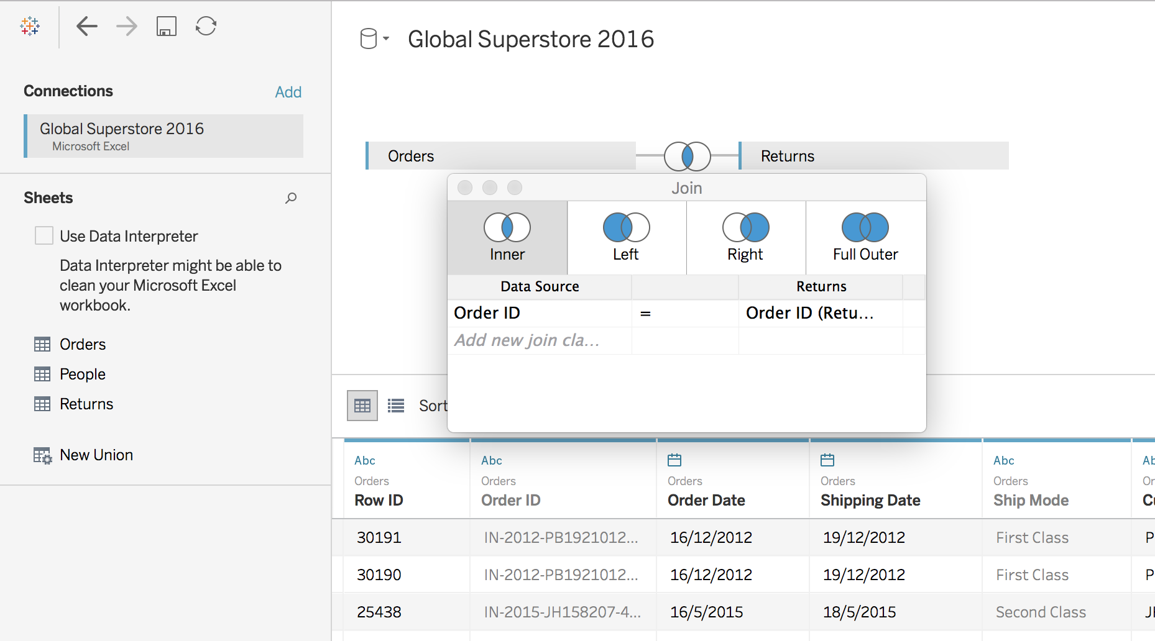
Tableau Speak – Table Join

Slide 23
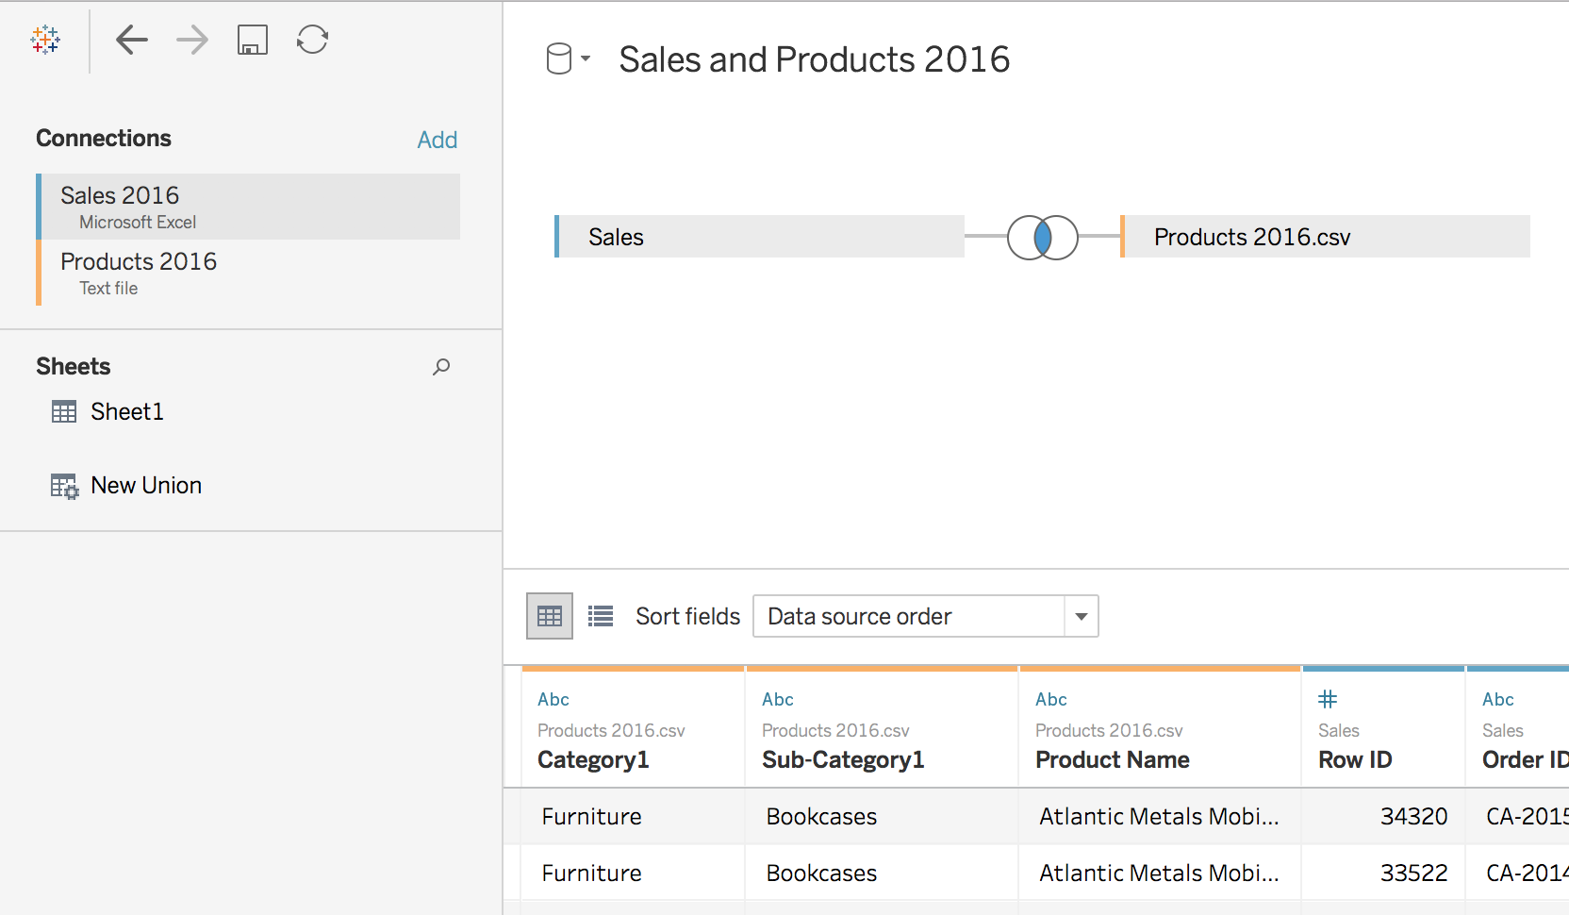
Tableau Speak – Cross-database Join

Slide 24
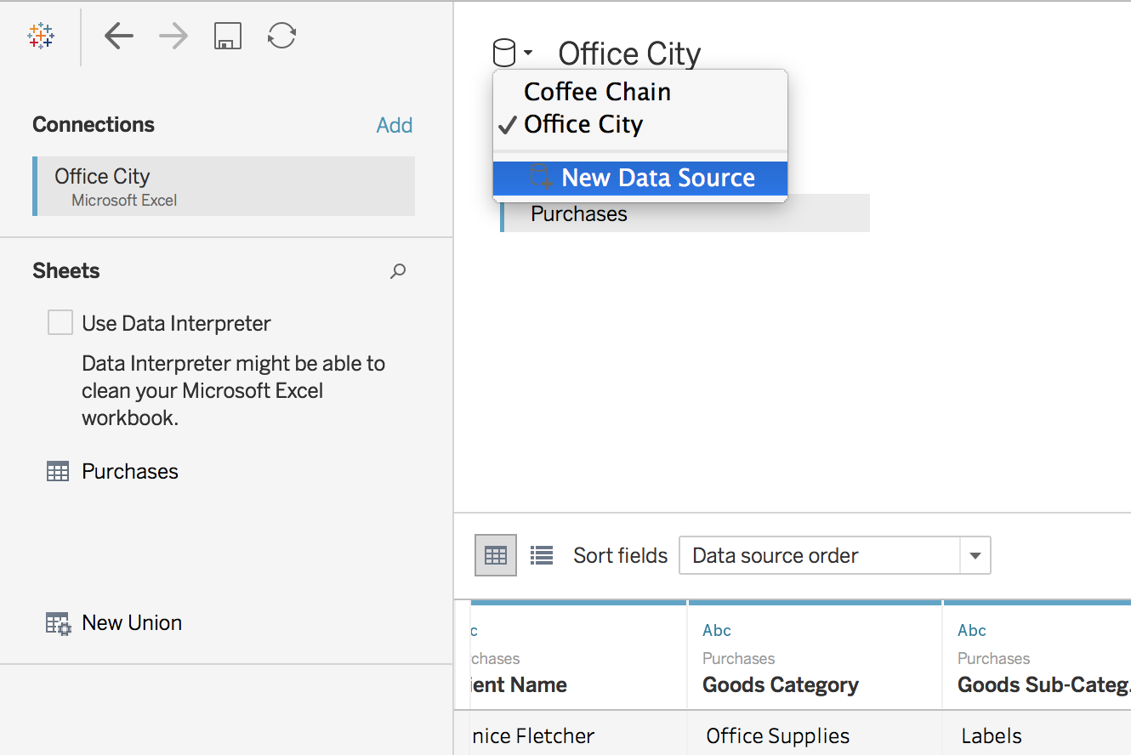
Tableau Speak – Data Blending

Slide 25
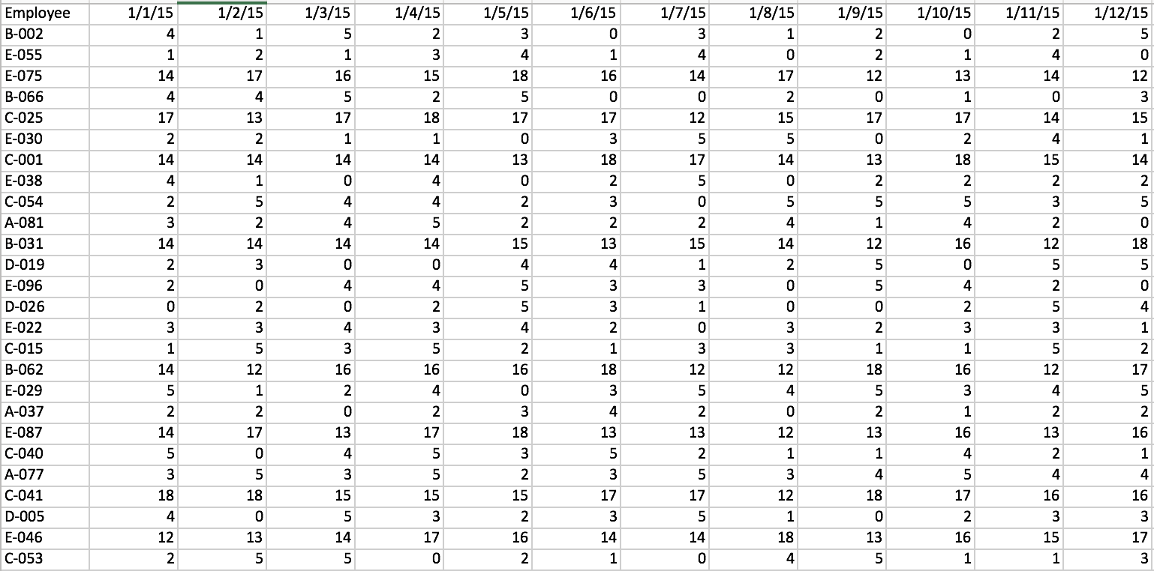
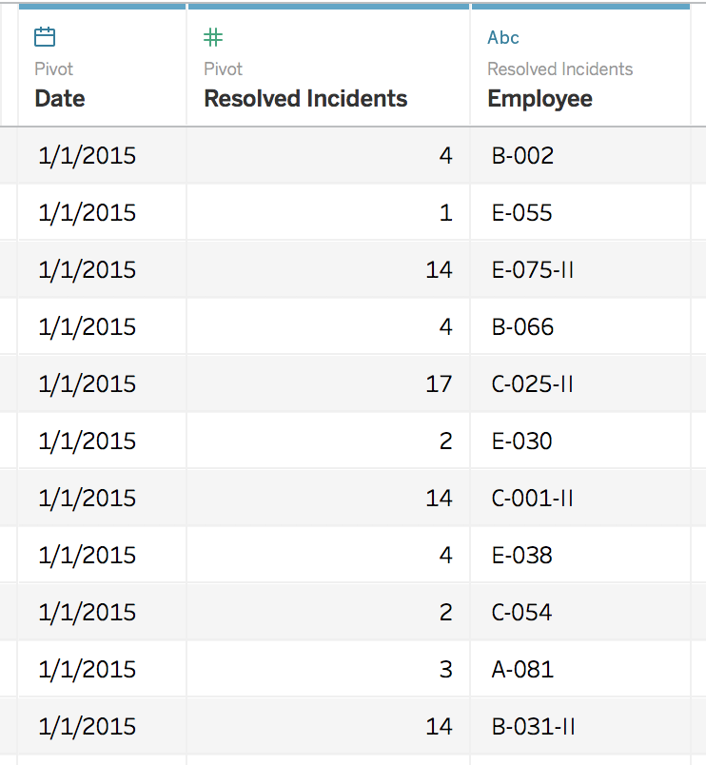
Tableau Speak – Pivot Data from Columns to Rows (or v.v.)
Pivot from wide to long format
Pivot from long to wide format

Slide 26
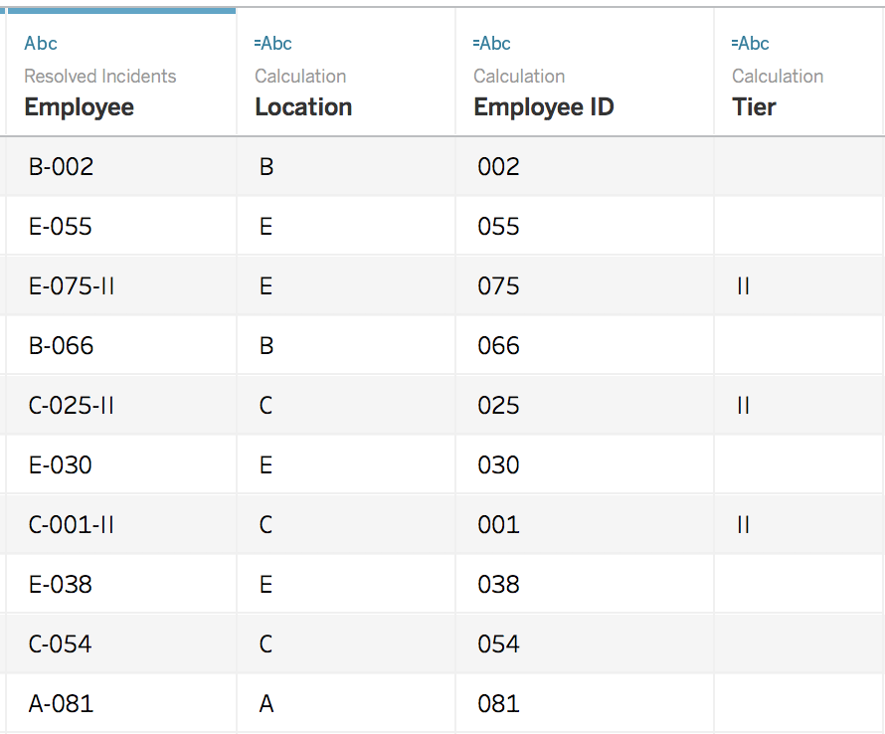
Tableau Speak – Split
Split “Employee” column:

Slide 27
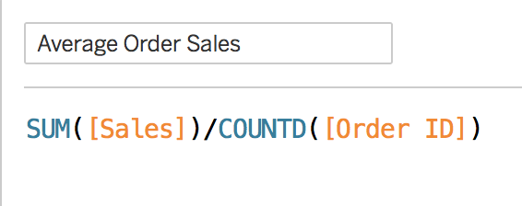
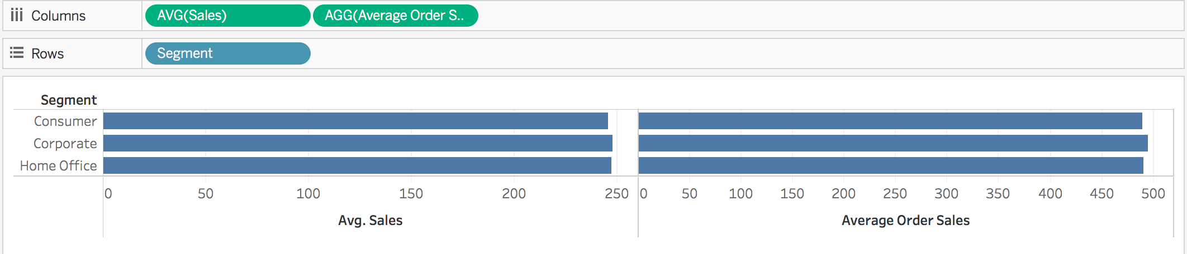
Tableau Speak – Calculation: Aggregate VS Record-Level

Slide 28
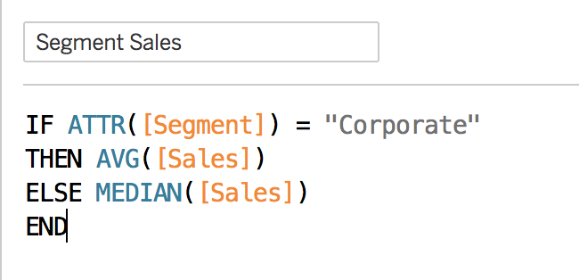
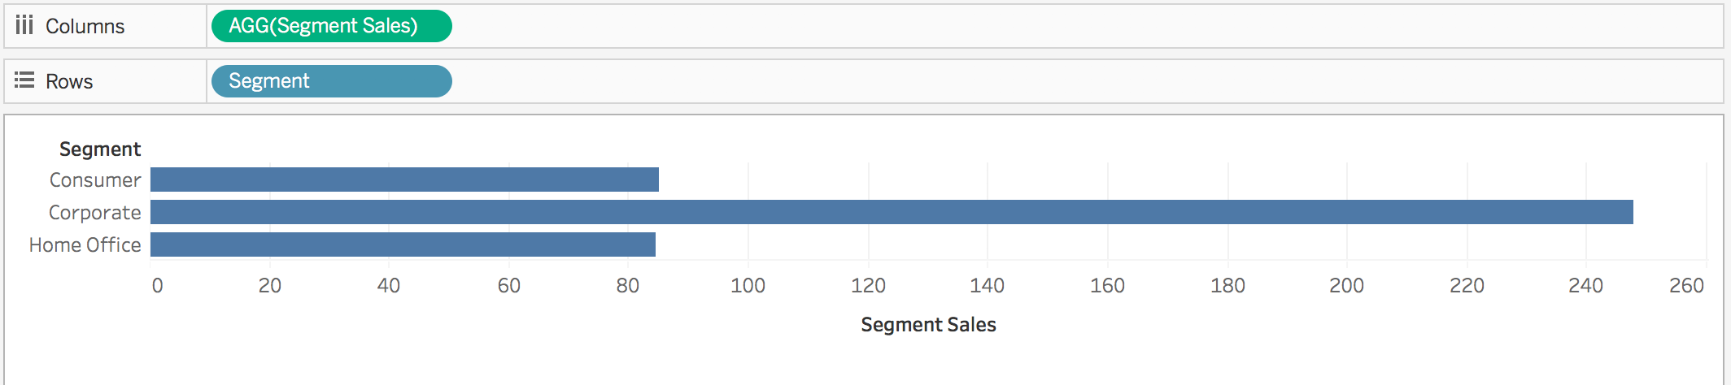
Tableau Speak –Aggregate Functions
Aggregation of a measure
Aggregation of a dimension

Slide 29
Part 4 – Basic Data Visualisation

Slide 30
Part 5 – Advanced Data Visualisation

Slide 31
Part 6 – Dashboard & Storyboards

Slide 32

Content + Image (Blue)
Have you always wanted to learn machine learning and AI, but been afraid of needing to learn programming?
Do you have a world changing business idea, but lack the skills to bring it to life?

Slide 33

Content + Image (Alt)
Data science is powerful, but programming is hard. There’s a great deal of interest in learning and applying machine learning and AI, but the number one thing holding people back is needing to learn to code (e.g., in Python, R, or C++) in order to use these techniques.

Slide 34

Content + Image (Alt, Blue)
Data science is powerful, but programming is hard. There’s a great deal of interest in learning and applying machine learning and AI, but the number one thing holding people back is needing to learn to code (e.g., in Python, R, or C++) in order to use these techniques.

Slide 35
Big Text + Title
Now you can harness the power of data science, no coding needed.

Slide 36
Big Text + Title (alt)
Now you can harness the power of data science, no coding needed.

Slide 37




References
The Robot Reference
Reference Number 2
Here’s some more info
Another point of info
A little info
Link to Reference
Link to Reference
Reference Name
Reference 4
Info
Reference info
Link to Reference
Link to Reference

Slide 38
References, No Images
The Robot Reference
Reference Number 2
Here’s some more info
Another point of info
A little info
Link to Reference
Link to Reference
Reference #3
Reference #4
Info here
Information
Link to Reference
Link to Reference

Slide 39
Title Only

Slide 40
Thank you!

